Slide 1

The Future of Work: Revolutionizing Freelancing
Welcome to the future of work. We're revolutionizing freelancing by connecting talented professionals with meaningful opportunities. This platform empowers individuals and businesses alike. Discover how we're shaping the next generation of work.

Slide 2
The Freelance Economy Landscape
Market Growth
$1.3T global market by 2024 59 million US freelancers
36% of the workforce is freelancing
Future Growth
The freelance market is booming. Expect a 50% growth over the next five years. The demand for skilled freelancers is increasing rapidly.

Slide 3



Problem: Freelancer Pain Points
Income Instability
Freelancers often struggle with inconsistent income.
Client Acquisition
Finding clients can be time- consuming and difficult.
Complex Payments
Managing payments and invoicing is a hassle.

Slide 4

Our Solution: NextWork Freelance Platform
AI Matching
AI-powered matching algorithm connects freelancers with the right jobs.
1
Integrated Payments
Easy payment and contract management streamline the process.
2
Skill Verification
Showcase verified skills and portfolios to attract clients.
3

Slide 5


Key Features
Zero Commission
Blockchain Verified
ML
Recommendatio ns
Secure Escrow
NextWork offers freelancers unique features. Enjoy zero commission for the first 3 months. Benefit from blockchain-verified skills and machine learning job recommendations.

Slide 6

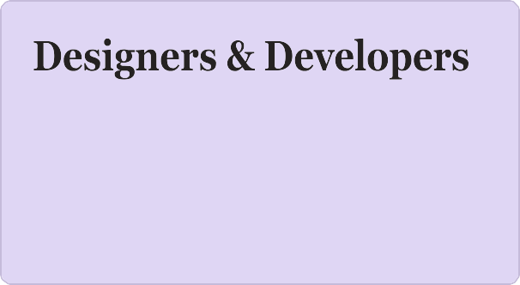
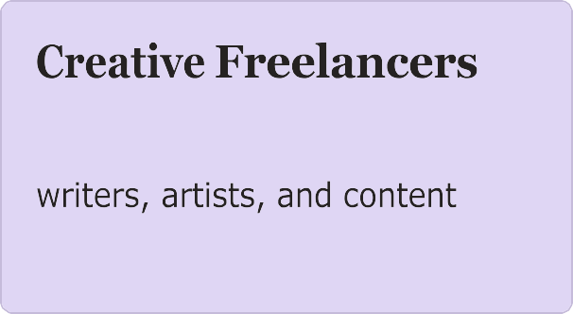
Target User Segments
Connecting independent professionals in tech and design.
Providing opportunities for
creators.
Consultants
Matching specialists with project-based consulting roles.

Slide 7



Business Model
2
3
NextWork offers multiple revenue streams. A freemium subscription model provides access to basic features. Premium features are available for advanced users. Enterprise client packages support larger organizations.

Slide 8

Vision and Future
Global Expansion
Scaling our platform to reach freelance professionals worldwide.
Continuous Innovation
Investing in new technologies to enhance the user experience and drive value.
Empowering Freelancers
Building the future of work by supporting independent professionals.

